Slide 1


Time & Clocks
CS 475: Concurrent & Distributed Systems (Fall 2021)
Lecture 6
Yue Cheng
Some material taken/derived from:
Princeton COS-418 materials created by Michael Freedman and Wyatt Lloyd.
MIT 6.824 by Robert Morris, Frans Kaashoek, and Nickolai Zeldovich.
Licensed for use under a Creative Commons Attribution-NonCommercial-ShareAlike 3.0 Unported License.

Slide 2
Today’s outline
The need for time synchronization
“Wall clock time” synchronization
Logical Time: Lamport Clocks
Vector clocks

Slide 3
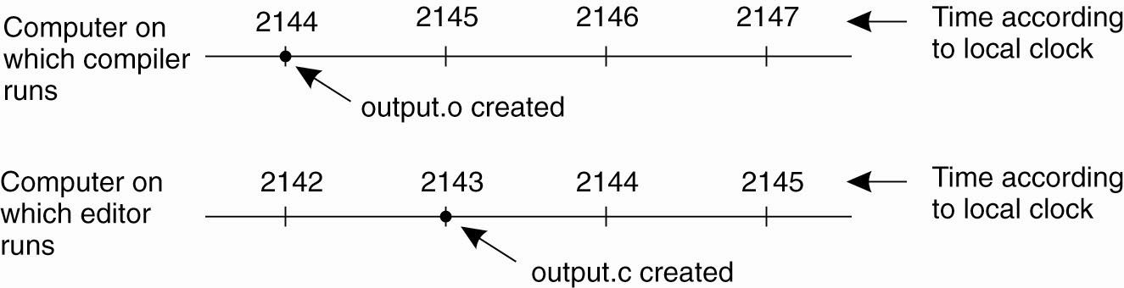
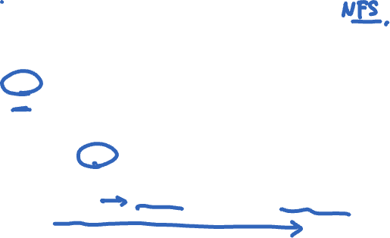
A distributed edit-compile workflow
Physical time →

Slide 4
A distributed edit-compile workflow
Physical time →
2143 < 2144 ➔ make doesn’t call compiler

Slide 5
A distributed edit-compile workflow
Physical time →
2143 < 2144 ➔ make doesn’t call compiler
Lack of time synchronization result – possible object file mismatch

Slide 6
What makes time synchronization hard?
Quartz oscillator sensitive to temperature, age, vibration, radiation
Accuracy ~one part per million
(one second of clock drift over 12 days)
The internet is:
Asynchronous: arbitrary message delays
Best-effort: messages don’t always arrive

Slide 7
Today’s outline
The need for time synchronization
“Wall clock time” synchronization
Cristian’s algorithm
Logical Time: Lamport Clocks
Vector clocks

Slide 8
Just use Coordinated Universal Time?
UTC is broadcast from radio stations on land and satellite (e.g., the Global Positioning System)
Computers with receivers can synchronize their clocks with these timing signals
Signals from land-based stations are accurate to about 0.1−10 milliseconds
Signals from GPS are accurate to about one microsecond
Why can’t we put GPS receivers on all our computers?

Slide 9


Synchronization to a time server
Suppose a server with an accurate clock (e.g., GPS-receiver)
Could simply issue an RPC to obtain the time:
Client
Server
Time of day?
2:50 PM
Time ↓

Slide 10
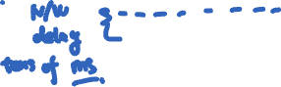
Synchronization to a time server
Suppose a server with an accurate clock (e.g., GPS-receiver)
Could simply issue an RPC to obtain the time:
But this doesn’t account for network latency
Message delays will have outdated server’s answer
Client
Server
Time of day?
2:50 PM
Time ↓

Slide 11
Cristian’s algorithm: Outline
Client
Server
Client sends a request packet, timestamped with its local clock T₁
T₁
request:
T₁
Time ↓

Slide 12
Cristian’s algorithm: Outline
Client
Server
Client sends a request packet, timestamped with its local clock T₁
Server timestamps its receipt of the request T₂ with its local clock
T₁
request:
T₁
T₂
Time ↓

Slide 13
Cristian’s algorithm: Outline
Client
Server
Client sends a request packet, timestamped with its local clock T₁
Server timestamps its receipt of the request T₂ with its local clock
Server sends a response packet with its local clock T₃ and T₂
T₁
request:
T₁
T₂
T₃
T₂,T₃
response:
Time ↓

Slide 14
Cristian’s algorithm: Outline
Client
Server
Client sends a request packet, timestamped with its local clock T₁
Server timestamps its receipt of the request T₂ with its local clock
Server sends a response packet with its local clock T₃ and T₂
Client locally timestamps its receipt of the server’s response T₄
T₁
request:
T₁
T₂
T₃
T₄
T₂,T₃
response:
Time ↓

Slide 15
Cristian’s algorithm: Outline
Client
Server
Client sends a request packet, timestamped with its local clock T₁
Server timestamps its receipt of the request T₂ with its local clock
Server sends a response packet with its local clock T₃ and T₂
Client locally timestamps its receipt of the server’s response T₄
T₁
request:
T₁
T₂
T₃
T₄
T₂,T₃
response:
Time ↓
How can the client use these timestamps to synchronize its local clock to the server’s local clock?

Slide 16
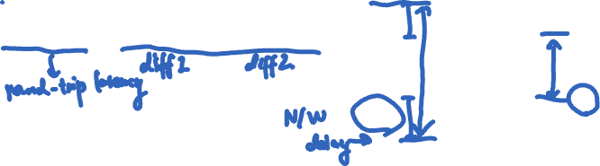
Cristian’s algorithm: Offset sample calculation
Client
Server
Goal: Client sets clock ← T₃ + 𝛿_{resp}
Client samples round trip time 𝛿 = 𝛿_{req} + 𝛿_{resp} = (T₄ − T₁) − (T₃ − T₂)
T₁
request:
T₁
𝛿_{req}
T₂
𝛿_{resp}
T₃
T₂,T₃
T₄
response:
Time ↓

Slide 17
Cristian’s algorithm: Offset sample calculation
Client
Server
Goal: Client sets clock ← T₃ + 𝛿_{resp}
Client samples round trip time 𝛿 = 𝛿_{req} + 𝛿_{resp} = (T₄ − T₁) − (T₃ − T₂)
T₁
request:
T₁
𝛿_{req}
T₂
𝛿_{resp}
T₃
T₂,T₃
T₄
response:
Time ↓

Slide 18
Cristian’s algorithm: Offset sample calculation
Client
Server
Goal: Client sets clock ← T₃ + 𝛿_{resp}
Client samples round trip time 𝛿 = 𝛿_{req} + 𝛿_{resp} = (T₄ − T₁) − (T₃ − T₂)
But client knows 𝛿, not 𝛿_{resp}
T₁
request:
T₁
𝛿_{req}
T₂
𝛿_{resp}
T₃
T₂,T₃
T₄
response:
Time ↓

Slide 19
Cristian’s algorithm: Offset sample calculation
Client
Server
Goal: Client sets clock ← T₃ + 𝛿_{resp}
Client samples round trip time 𝛿 = 𝛿_{req} + 𝛿_{resp} = (T₄ − T₁) − (T₃ − T₂)
But client knows 𝛿, not 𝛿_{resp}
T₁
request:
T₁
𝛿_{req}
T₂
𝛿_{resp}
T₃
Assume: 𝛿_{req} ≈ 𝛿_{resp}
T₂,T₃
T₄
response:
Time ↓

Slide 20
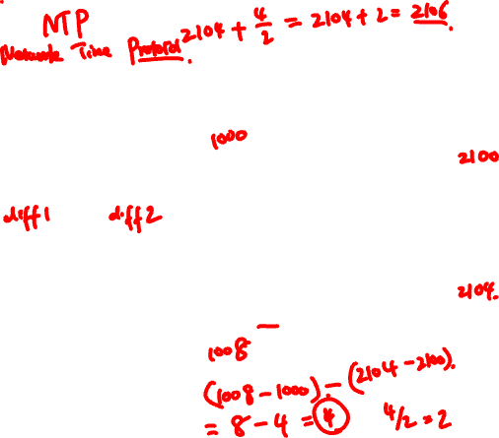
Cristian’s algorithm: Offset sample calculation
Client
Server
Goal: Client sets clock ← T₃ + 𝛿_{resp}
Client samples round trip time 𝛿 = 𝛿_{req} + 𝛿_{resp} = (T₄ − T₁) − (T₃ − T₂)
But client knows 𝛿, not 𝛿_{resp}
T₁
request:
T₁
𝛿_{req}
T₂
𝛿_{resp}
T₃
Assume: 𝛿_{req} ≈ 𝛿_{resp}
T₂,T₃
T₄
response:
Client sets clock ← T₃ + ½𝛿
Time ↓

Slide 21
Clock synchronization: Takeaway points
Clocks on different systems will always behave differently
Disagreement between machines can result in undesirable behavior

Slide 22
Clock synchronization: Takeaway points
Clocks on different systems will always behave differently
Disagreement between machines can result in undesirable behavior
Clock synchronization algorithms
Rely on timestamps to estimate network delays
100s 𝝁s−ms accuracy
Clocks never exactly synchronized

Slide 23
Clock synchronization: Takeaway points
Clocks on different systems will always behave differently
Disagreement between machines can result in undesirable behavior
Clock synchronization algorithms
Rely on timestamps to estimate network delays
100s 𝝁s−ms accuracy
Clocks never exactly synchronized
Often inadequate for distributed systems
Often need to reason about the order of events
Might need precision on the order of ns

Slide 24
Today’s outline
The need for time synchronization
“Wall clock time” synchronization
Cristian’s algorithm
Logical Time: Lamport Clocks
Vector clocks

Slide 25
Motivation: Multi-site database replication
A New York-based bank wants to make its transaction ledger database resilient to whole-site failures
New York

Slide 26
Motivation: Multi-site database replication
A New York-based bank wants to make its transaction ledger database resilient to whole-site failures
Replicate the database, keep one copy in SF, one in NYC
San Francisco
New York

Slide 27
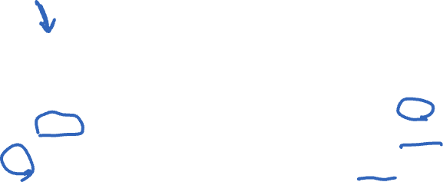
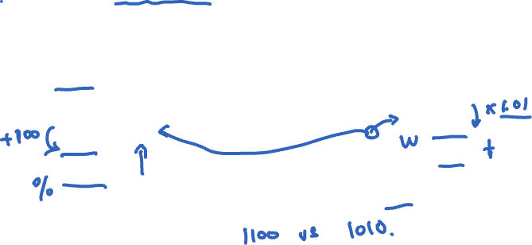
The consequences of concurrent updates
Replicate the database, keep one copy in SF, one in NYC
Client sends reads to the nearest copy
Client sends update to both copies
“Deposit
$100”
Inconsistent replicas!
Updates should have been performed in the same order at each copy
$1,000
$1,000
$1,010
$1,100
$1,110
$1,111
“Pay 1%
interest”

Slide 28
Idea: Logical clocks
Landmark 1978 paper by Leslie Lamport

Slide 29
Idea: Logical clocks
Landmark 1978 paper by Leslie Lamport
Insights: only the events themselves matter
Idea: Disregard the precise clock time
Instead, capture just a “happens before” relationship between a pair of events

Slide 30
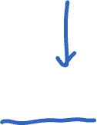
Defining “happens-before” (→)
Consider three processes: P1, P2, and P3
Notation: Event a happens before event b (a → b)
P1
P2
P3
Physical time ↓

Slide 31

Defining “happens-before” (→)
Can observe event order at a single process
P1
P2
P3
a
b
Physical time ↓

Slide 32
Defining “happens-before” (→)
If same process and a occurs before b, then a → b
P1
P2
P3
a
b
Physical time ↓

Slide 33
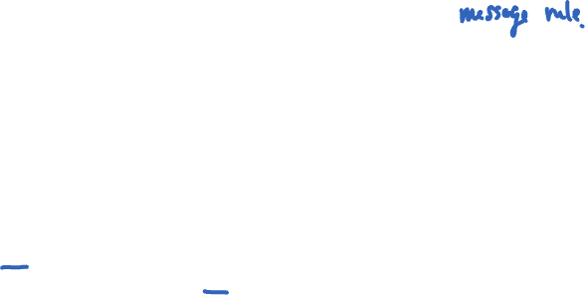
Defining “happens-before” (→)
If same process and a occurs before b, then a → b
Can observe ordering when processes communicate
P1
P2
P3
a
b
c
Physical time ↓

Slide 34
Defining “happens-before” (→)
If same process and a occurs before b, then a → b
If c is a message receipt of b, then b → c
P1
P2
P3
a
b
c
Physical time ↓

Slide 35
Defining “happens-before” (→)
If same process and a occurs before b, then a → b
If c is a message receipt of b, then b → c
Can observe ordering transitively
P1
P2
P3
a
b
c
Physical time ↓

Slide 36
Defining “happens-before” (→)
If same process and a occurs before b, then a → b
If c is a message receipt of b, then b → c
If a → b and b → c, then a → c
P1
P2
P3
a
b
c
Physical time ↓

Slide 37

Defining “happens-before” (→)
Not all events are related by →
P1
P2
P3
a
d
b
c
Physical time ↓

Slide 38

Defining “happens-before” (→)
Not all events are related by →
a, d not related by → so concurrent, written as a || d
P1
P2
P3
a
d
b
c
Physical time ↓

Slide 39

Lamport clocks: Objective
We seek a clock time C(a) for every event a
Clock condition: If a → b, then C(a) < C(b)
Plan: Tag events with clock times; use clock times to make distributed system correct

Slide 40
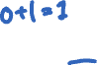
The Lamport Clock algorithm
Each process P_{i} maintains a local clock C_{i}
Before executing an event, C_{i} ← C_{i} + 1:
P1
C₁=0
P2
C₂=0
P3
C₃=0
a
b
c
Physical time ↓

Slide 41
The Lamport Clock algorithm
Before executing an event a, C_{i} ← C_{i} + 1:
Set event time C(a) ← C_{i}
P1
C₁=1
P2
C₂=0
P3
C₃=0
C(a) = 1
a
b
c
Physical time ↓

Slide 42
The Lamport Clock algorithm
Before executing an event b, C_{i} ← C_{i} + 1:
Set event time C(b) ← C_{i}
P1
C₁=2
P2
C₂=0
P3
C₃=0
C(a) = 1
a
C(b) = 2
b
c
Physical time ↓

Slide 43
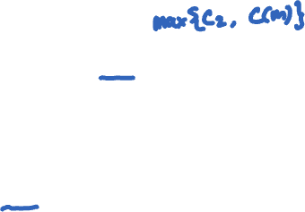
The Lamport Clock algorithm
Before executing an event b, C_{i} ← C_{i} + 1
Send the local clock in the message m
P1
C₁=2
P2
C₂=0
P3
C₃=0
C(a) = 1
a
C(b) = 2
b
c
C(m) = 2
Physical time ↓

Slide 44
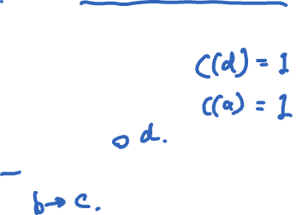
The Lamport Clock algorithm
On process P_{j} receiving a message m:
Set C_{j} and receive event time C(c) ←1 + max{ C_{j}, C(m) }
P1
C₁=2
P2
C₂=3
P3
C₃=0
C(a) = 1
a
C(b) = 2
C(c) = 3
b
c
C(m) = 2
Physical time ↓

Slide 45

Lamport Timestamps: Ordering all events
Break ties by appending the process number to each event:
Process P_{i} timestamps event e with C_{i}(e).i
C(a).i < C(b).j when:
C(a) < C(b), or C(a) = C(b) and i < j
Now, for any two events a and b, C(a) < C(b) or C(b) < C(a)
This is called a total ordering of events

Slide 46
Order all these events
P1
C₁=0
P2
C₂=0
P3
C₃=0
P4
C₄=0
a
b
d
f
h
c
e
i
g
Physical time ↓

Slide 47
Totally-Ordered Multicast
Goal: All sites apply updates in (same) Lamport clock order
Client sends update to one replica site j
Replica assigns it Lamport timestamp C_{j} . j

Slide 48
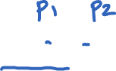
Totally-Ordered Multicast
Goal: All sites apply updates in (same) Lamport clock order
Client sends update to one replica site j
Replica assigns it Lamport timestamp C_{j} . j
Key idea: Place events into a sorted local queue
Sorted by increasing Lamport timestamps
Example: P1’s
local queue:
1.1
1.2
← Timestamps
$
%
P1

Slide 49
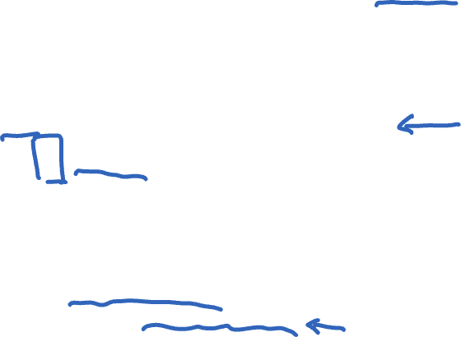
Totally-Ordered Multicast ^{(Almost correct)}
On receiving an update from client, broadcast to others (including yourself)
On receiving an update from replica:
Add it to your local queue
Broadcast an acknowledgement message to every replica (including yourself)
On receiving an acknowledgement:
Mark corresponding update acknowledged in your queue
Remove and process updates everyone has ack’ed from head of queue

Slide 50
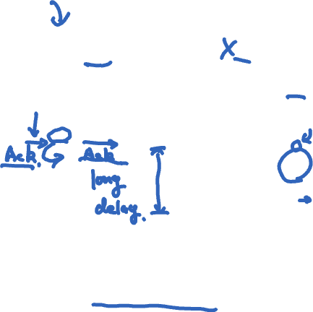
Totally-Ordered Multicast ^{(Almost correct)}
P1 queues $, P2 queues %
P1 queues and ack’s %
P1 marks % fully ack’ed
P2 marks % fully ack’ed
1.1
1.2
1.2
$
%
%
✔
✔
P2
P1
1.1
1.2
$
%
ack
%
%
✘ P2 processes %
(Ack’s to self not shown here)

Slide 51
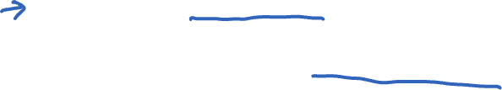
Totally-Ordered Multicast ^{(Correct version)}
On receiving an update from client, broadcast to others (including yourself)
On receiving or processing an update:
Add it to your local queue
Broadcast an acknowledgement message to every replica (including yourself) only from head of queue
On receiving an acknowledgement:
Mark corresponding update acknowledged in your queue
Remove and process updates everyone has ack’ed from head of queue

Slide 52
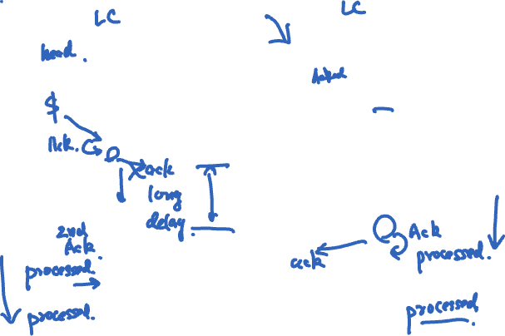
Totally-Ordered Multicast ^{(Correct version)}
1.1
1.2
1.1
1.2
$
%
$
%
✔
✔
✔
✔
P2
P1
1.1
1.2
$
%
ack
$
$
$
ack
%
%
%
(Ack’s to self not shown here)

Slide 53
So, are we done?
Does totally-ordered multicast solve the problem of multi-site replication in general?

Slide 54
So, are we done?
Does totally-ordered multicast solve the problem of multi-site replication in general?
Not by a long shot!
Our protocol assumed:
No node failures
No message loss
No message corruption

Slide 55
So, are we done?
Does totally-ordered multicast solve the problem of multi-site replication in general?
Not by a long shot!
Our protocol assumed:
No node failures
No message loss
No message corruption
All-to-all communication does not scale

Slide 56
So, are we done?
Does totally-ordered multicast solve the problem of multi-site replication in general?
Not by a long shot!
Our protocol assumed:
No node failures
No message loss
No message corruption
All-to-all communication does not scale
Waits forever for message delays (performance?)

Slide 57
Lamport Clocks: Takeaway points
Can totally-order events in a distributed system: that’s useful!
We saw an application of Lamport clocks for totally-ordered multicast

Slide 58
Lamport Clocks: Takeaway points
Can totally-order events in a distributed system: that’s useful!
We saw an application of Lamport clocks for totally-ordered multicast
But: while by construction,
a → b implies C(a) < C(b),
The converse is not necessarily true:
C(a) < C(b) does not imply a → b (possibly, a || b)

Slide 59
Lamport Clocks: Takeaway points
Can totally-order events in a distributed system: that’s useful!
We saw an application of Lamport clocks for totally-ordered multicast
But: while by construction,
a → b implies C(a) < C(b),
The converse is not necessarily true:
C(a) < C(b) does not imply a → b (possibly, a || b)
Can’t use Lamport timestamps to infer causal relationships between events

Slide 60
Today’s outline
The need for time synchronization
“Wall clock time” synchronization
Cristian’s algorithm
Logical Time: Lamport Clocks
Vector clocks

Slide 61
Lamport Clocks and causality
Lamport clock timestamps do not capture causality
Given two timestamps C(a) and C(z), want to know whether there’s a chain of events linking them:
a → b → ... → y → z

Slide 62
Vector clock: Introduction
One integer can’t order events in more than one process
So, a Vector Clock (VC) is a vector of integers, one entry for each process in the entire distributed system
Label event e with VC(e) = [c₁, c₂ …, c_{n}]
Each entry c_{k} is a count of events in process k that causally precede e

Slide 63
Vector clock: Update rules
Initially, all vectors are [0, 0, …, 0]
Two update rules:
For each local event on process i, increment local entry c_{i}

Slide 64
Vector clock: Update rules
Initially, all vectors are [0, 0, …, 0]
Two update rules:
For each local event on process i, increment local entry c_{i}
If process j receives message with vector [d₁, d₂, …, d_{n}]:
Set each local entry c_{k} = max{c_{k}, d_{k}}
Increment local entry c_{j}

Slide 65
Vector clock: Example
All processes’ VCs start at [0, 0, 0]
P1
P2
P3
a
e
b
c
d
f
Physical time ↓

Slide 66
Vector clock: Example
All processes’ VCs start at [0, 0, 0]
Applying local update rule
P1
P2
P3
a
e
b
c
d
f
Physical time ↓

Slide 67
Vector clock: Example
All processes’ VCs start at [0, 0, 0]
Applying local update rule
P1
P2
P3
a
[1,0,0]
e
b
c
d
f
Physical time ↓

Slide 68
Vector clock: Example
All processes’ VCs start at [0, 0, 0]
Applying local update rule
P1
P2
P3
a
[1,0,0]
e
[2,0,0]
b
c
d
f
Physical time ↓

Slide 69
Vector clock: Example
All processes’ VCs start at [0, 0, 0]
Applying local update rule
Applying message rule
Local vector clock piggybacks on inter-process messages
P1
P2
P3
a
[1,0,0]
e
[2,0,0]
b
c
d
f
Physical time ↓

Slide 70
Vector clock: Example
All processes’ VCs start at [0, 0, 0]
Applying local update rule
Applying message rule
Local vector clock piggybacks on inter-process messages
P1
P2
P3
a
[1,0,0]
e
[2,0,0]
b
[2,0,0]
[2,1,0]
c
d
f
Physical time ↓

Slide 71
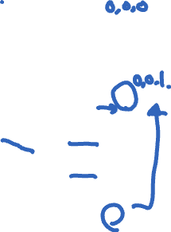
Vector clock: Example
All processes’ VCs start at [0, 0, 0]
Applying local update rule
Applying message rule
Local vector clock piggybacks on inter-process messages
P1
P2
P3
a
[1,0,0]
e
[2,0,0]
b
[2,0,0]
[2,1,0]
c
[2,2,0]
d
f
Physical time ↓

Slide 72

Vector clock: Example
All processes’ VCs start at [0, 0, 0]
Applying local update rule
Applying message rule
Local vector clock piggybacks on inter-process messages
P1
P2
P3
a
[1,0,0]
e
[0,0,1]
[2,0,0]
b
[2,0,0]
[2,1,0]
c
[2,2,0]
d
[2,2,0]
[2,2,2]
f
Physical time ↓

Slide 73

Comparing vector timestamps
Rule for comparing vector timestamps:
V(a) = V(b) when a_{k} = b_{k} for all k
V(a) < V(b) when a_{k} ≤ b_{k} for all k and V(a) ≠ V(b)
Concurrency:
V(a) || V(b) if a_{i} < b_{i} and a_{j} > b_{j}, some i, j

Slide 74
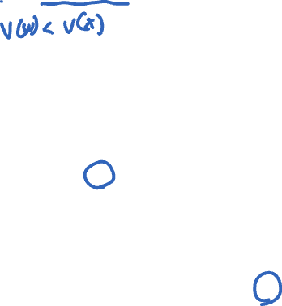
Vector clocks capture causality
V(w) < V(z) then there is a chain of events linked by Happens-Before (→) between a and z
P1
P2
P3
[1,0,0]
w
[2,0,0]
x
[2,1,0]
y
z
[2,2,0]

Slide 75
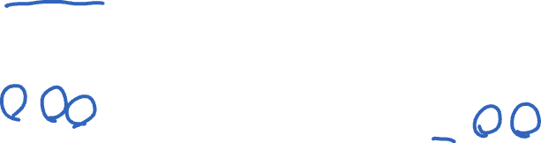
Vector clocks capture causality
V(w) < V(z) then there is a chain of events linked by Happens-Before (→) between a and z
V(a) || V(w) then there is no such chain of events between a and w
P1
P2
P3
[1,0,0]
w
a
[0,0,1]
[2,0,0]
x
[2,1,0]
y
z
[2,2,0]

Slide 76
Comparing vector timestamps
Rule for comparing vector timestamps:
V(a) = V(b) when a_{k} = b_{k} for all k
They are the same event
V(a) < V(b) when a_{k} ≤ b_{k} for all k and V(a) ≠ V(b)
a → b
Concurrency:
V(a) || V(b) if a_{i} < b_{i} and a_{j} > b_{j}, some i, j
a || b

Slide 77

Two events a, z
Lamport clocks: C(a) < C(z)
Conclusion: z -/-> a, i.e., either a → z or a || z
Vector clocks: V(a) < V(z)
Conclusion: a → z

Slide 78
Two events a, z
Lamport clocks: C(a) < C(z)
Conclusion: z -/-> a, i.e., either a → z or a || z
Vector clocks: V(a) < V(z)
Conclusion: a → z
Vector clock timestamps precisely capture happens-before relation (potential causality)

